Slide 1
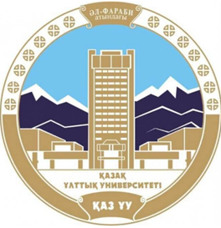
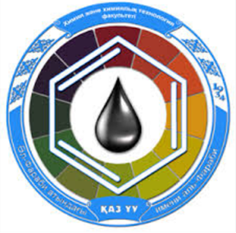
Types of solid-state thermal transformations of coordination compounds.
Al-Farabi Kazakh National University
Faculty of Chemistry and Chemical technology
Department of General and Inorganic Chemistry
PhD Bakhadur Askar

Slide 2

Solid-state transformations
Solid-state thermal transformations refer to chemical and structural changes that occur in coordination compounds when they are heated without melting or dissolving. These processes involve the breaking and formation of metal–ligand bonds, rearrangement of the coordination sphere, and possible phase transitions in the crystalline lattice.
Unlike reactions in solution, solid-state transformations proceed via diffusion-controlled mechanisms and often lead to stepwise decomposition of complexes. Understanding these transformations is essential for:
Designing thermally stable materials,
Producing metal oxides and catalysts, and
Interpreting thermogravimetric (TGA) or DSC data in analytical chemistry

Slide 3
General characteristics of thermal transformations
When coordination compounds are heated, several processes can occur:
Loss of lattice or coordinated solvent molecules (e.g., water, ammonia).
Decomposition of ligands accompanied by release of gases (CO₂, NO, SO₂, etc.).
Reduction or oxidation of the central metal ion.
Transformation into oxides, sulfides, or mixed-metal phases.
These transformations are often endothermic in the early stages (due to bond breaking) and exothermic in later stages (due to formation of stable oxides or new lattices). The exact pathway depends on the metal–ligand bond strength, crystal structure, and atmosphere during heating (air, inert gas, vacuum).

Slide 4

Dehydration and desolvation processes
Many coordination compounds crystallize as hydrates or solvates containing water or solvent molecules in the lattice. Upon heating, these molecules are released in one or several stages:
Lattice water is lost at low temperatures (below 150 °C).
Coordinated water (directly bound to the metal center) is released at higher temperatures, often causing a change in coordination number or geometry.
Example:
$$\left[Cu\left(H_{2}O{\left.)\right.}_{6}{\left.]\right.}^{2+}\underset{→}{\text{heat}}\left[Cu\left(H_{2}O{\left.)\right.}_{4}{\left.]\right.}^{2+}+2H_{2}O\underset{→}{\text{further} \text{heating}}CuO+volatileproducts\right.\right.\right.\right.$$
Dehydration often triggers structural rearrangements and affects the color, magnetic properties, and

Slide 5
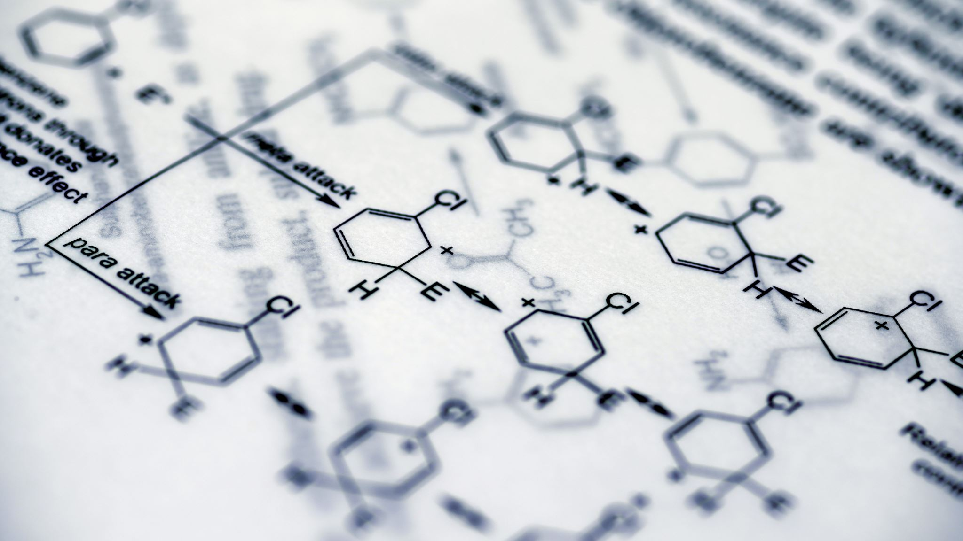
Ligand loss and structural rearrangement
After desolvation, complexes may undergo partial or complete loss of organic or inorganic ligands. Ligand loss is typically endothermic, requiring energy to break coordination bonds.
The compound may then:
Rearrange into a new coordination geometry (e.g., octahedral → tetrahedral).
Form polymeric structures where neighboring metal centers bridge through remaining ligands.
Exhibit color changes due to altered d–orbital splitting.
Structural rearrangements are key in forming intermediate phases, which may persist over limited temperature ranges before full decomposition. These transformations can be reversible or irreversible depending on the system’s lattice rigidity and bonding.

Slide 6

Thermal decomposition and redox processes
With further heating, many complexes undergo thermochemical decomposition, producing simpler compounds, gases, or metallic residues.
Oxidative decomposition (in air): the metal is converted into its oxide, and ligands are oxidized to volatile products such as CO₂ or NO₂.
Reductive decomposition (in inert atmosphere): the metal ion may be reduced to a lower oxidation state or even to the metallic form.
Example:
$$\left[Fe\left(C_{2}O_{4}{\left.)\right.}_{3}{\left.]\right.}^{3−}\underset{→}{\text{heat}}Fe_{2}O_{3}+CO_{2}+CO\right.\right.$$
These redox-driven transformations are important for preparing catalysts, nanostructured oxides, and metal nanoparticles.

Slide 7
Solid-state mechanisms and kinetic aspects
Thermal reactions in the solid state occur through nucleation and diffusion-controlled mechanisms. Reactions often start at crystal defects, grain boundaries, or surfaces where atomic mobility is higher.
The process can include:
Nucleation of a new phase,
Growth of the product layer,
Diffusion of volatile fragments through the solid matrix.
The rate and pathway of transformation depend on:
Particle size and porosity,
Heating rate,
Atmospheric conditions.
Kinetic studies using thermogravimetry (TGA) and differential scanning calorimetry (DSC) provide activation energies and help identify intermediate stages.

Slide 8

Significance
Analytical chemistry: used to determine composition and stability by TGA or DTA profiles.
Materials science: precursor design for metal oxides, ceramics, pigments, and catalysts.
Environmental chemistry: understanding decomposition pathways to control emission of toxic gases.
Coordination synthesis: identifying stable intermediates for controlled thermal reactions.

Slide 9
Summary
Solid-state thermal transformations involve stepwise changes such as desolvation, ligand removal, redox reactions, and oxide formation.
These processes occur without melting, primarily governed by diffusion and nucleation mechanisms.
Dehydration and ligand loss modify the coordination sphere and can lead to new solid phases.
Oxidative or reductive decomposition yields metal oxides or elemental metals, important in catalysis and materials production.
Thermoanalytical methods reveal detailed kinetic and structural information.
Solid-state thermal transformations of coordination compounds represent a bridge between molecular coordination chemistry and materials science. By understanding how heat alters the coordination environment, chemists can control the synthesis of functional solids—from catalysts and ceramics to nanomaterials—through predictable, stepwise thermal processes.

Slide 10
Thank you for attention!

